Slide 1



MINI-project
Project Name: Student Record System Course: BCA-Data Science Section: BCD-1 (B) Subject: Data Structure Lab Submitted by: Shlok Mahajan UID: 24BCD10032 Submitted to: Mehak Bhatia

Slide 2
Student record system
By: shlok mahajan

Slide 3
Description and overview
Project Overview
Description: A console-based application to manage student records using linked lists for storage.
Key Features:
Add, view, search, and delete student records.
Automatic calculation of total marks and percentage.
Dynamic memory management.

Slide 4
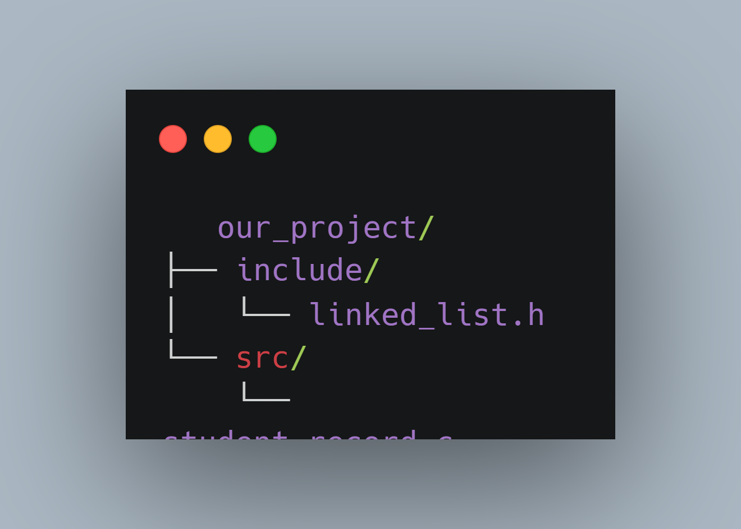
Project structure
Project Structure
Components:
linked_list.h: Generic linked list implementation.
student_record.c: Core logic for student record management.
Data Flow:
User inputs → Linked list operations → Output display.

Slide 5
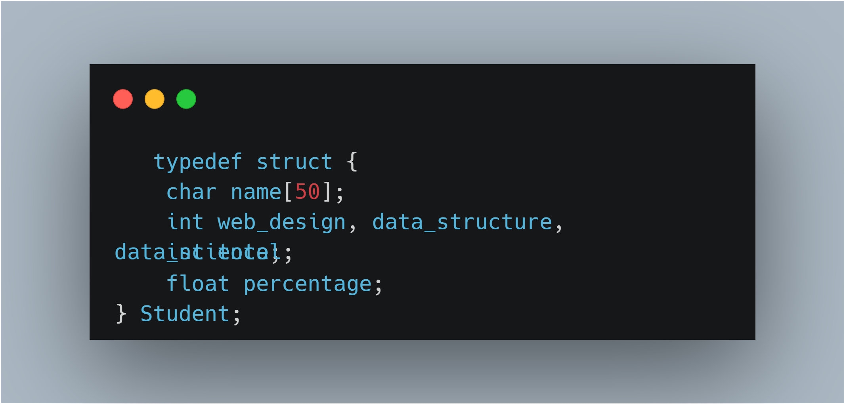
Data structure used
Linked list
Student Record Structure
typedef struct { char name[50];
int web_design, data_structure, data_science; int total;
float percentage; } Student;

Slide 6
Core functions used
Core Functions
createStudentRecord()
Allocates memory for a new student record.
insertNode()
Adds a record to the linked list.
searchNode()
Finds a record by name.
deleteNode()
Removes a record from the list.

Slide 7
Callback functions used
Callback Functions
calculateStudentStats()
calculation of percentage
displayStudent()
Prints formatted student details.
compareStudents()
Compares records by name (lexicographically).
freeStudent()
Releases memory allocated for a record.

Slide 8
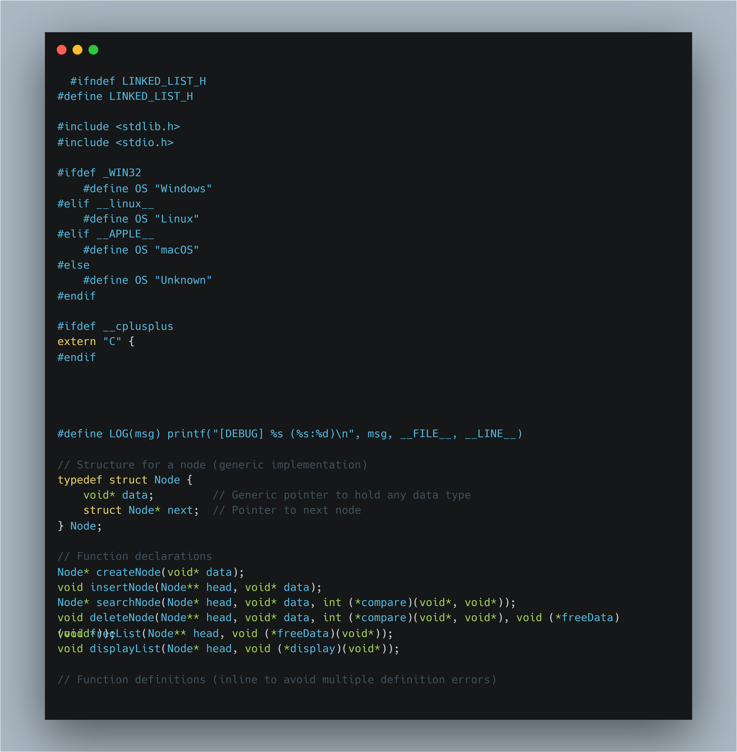

Slide 9
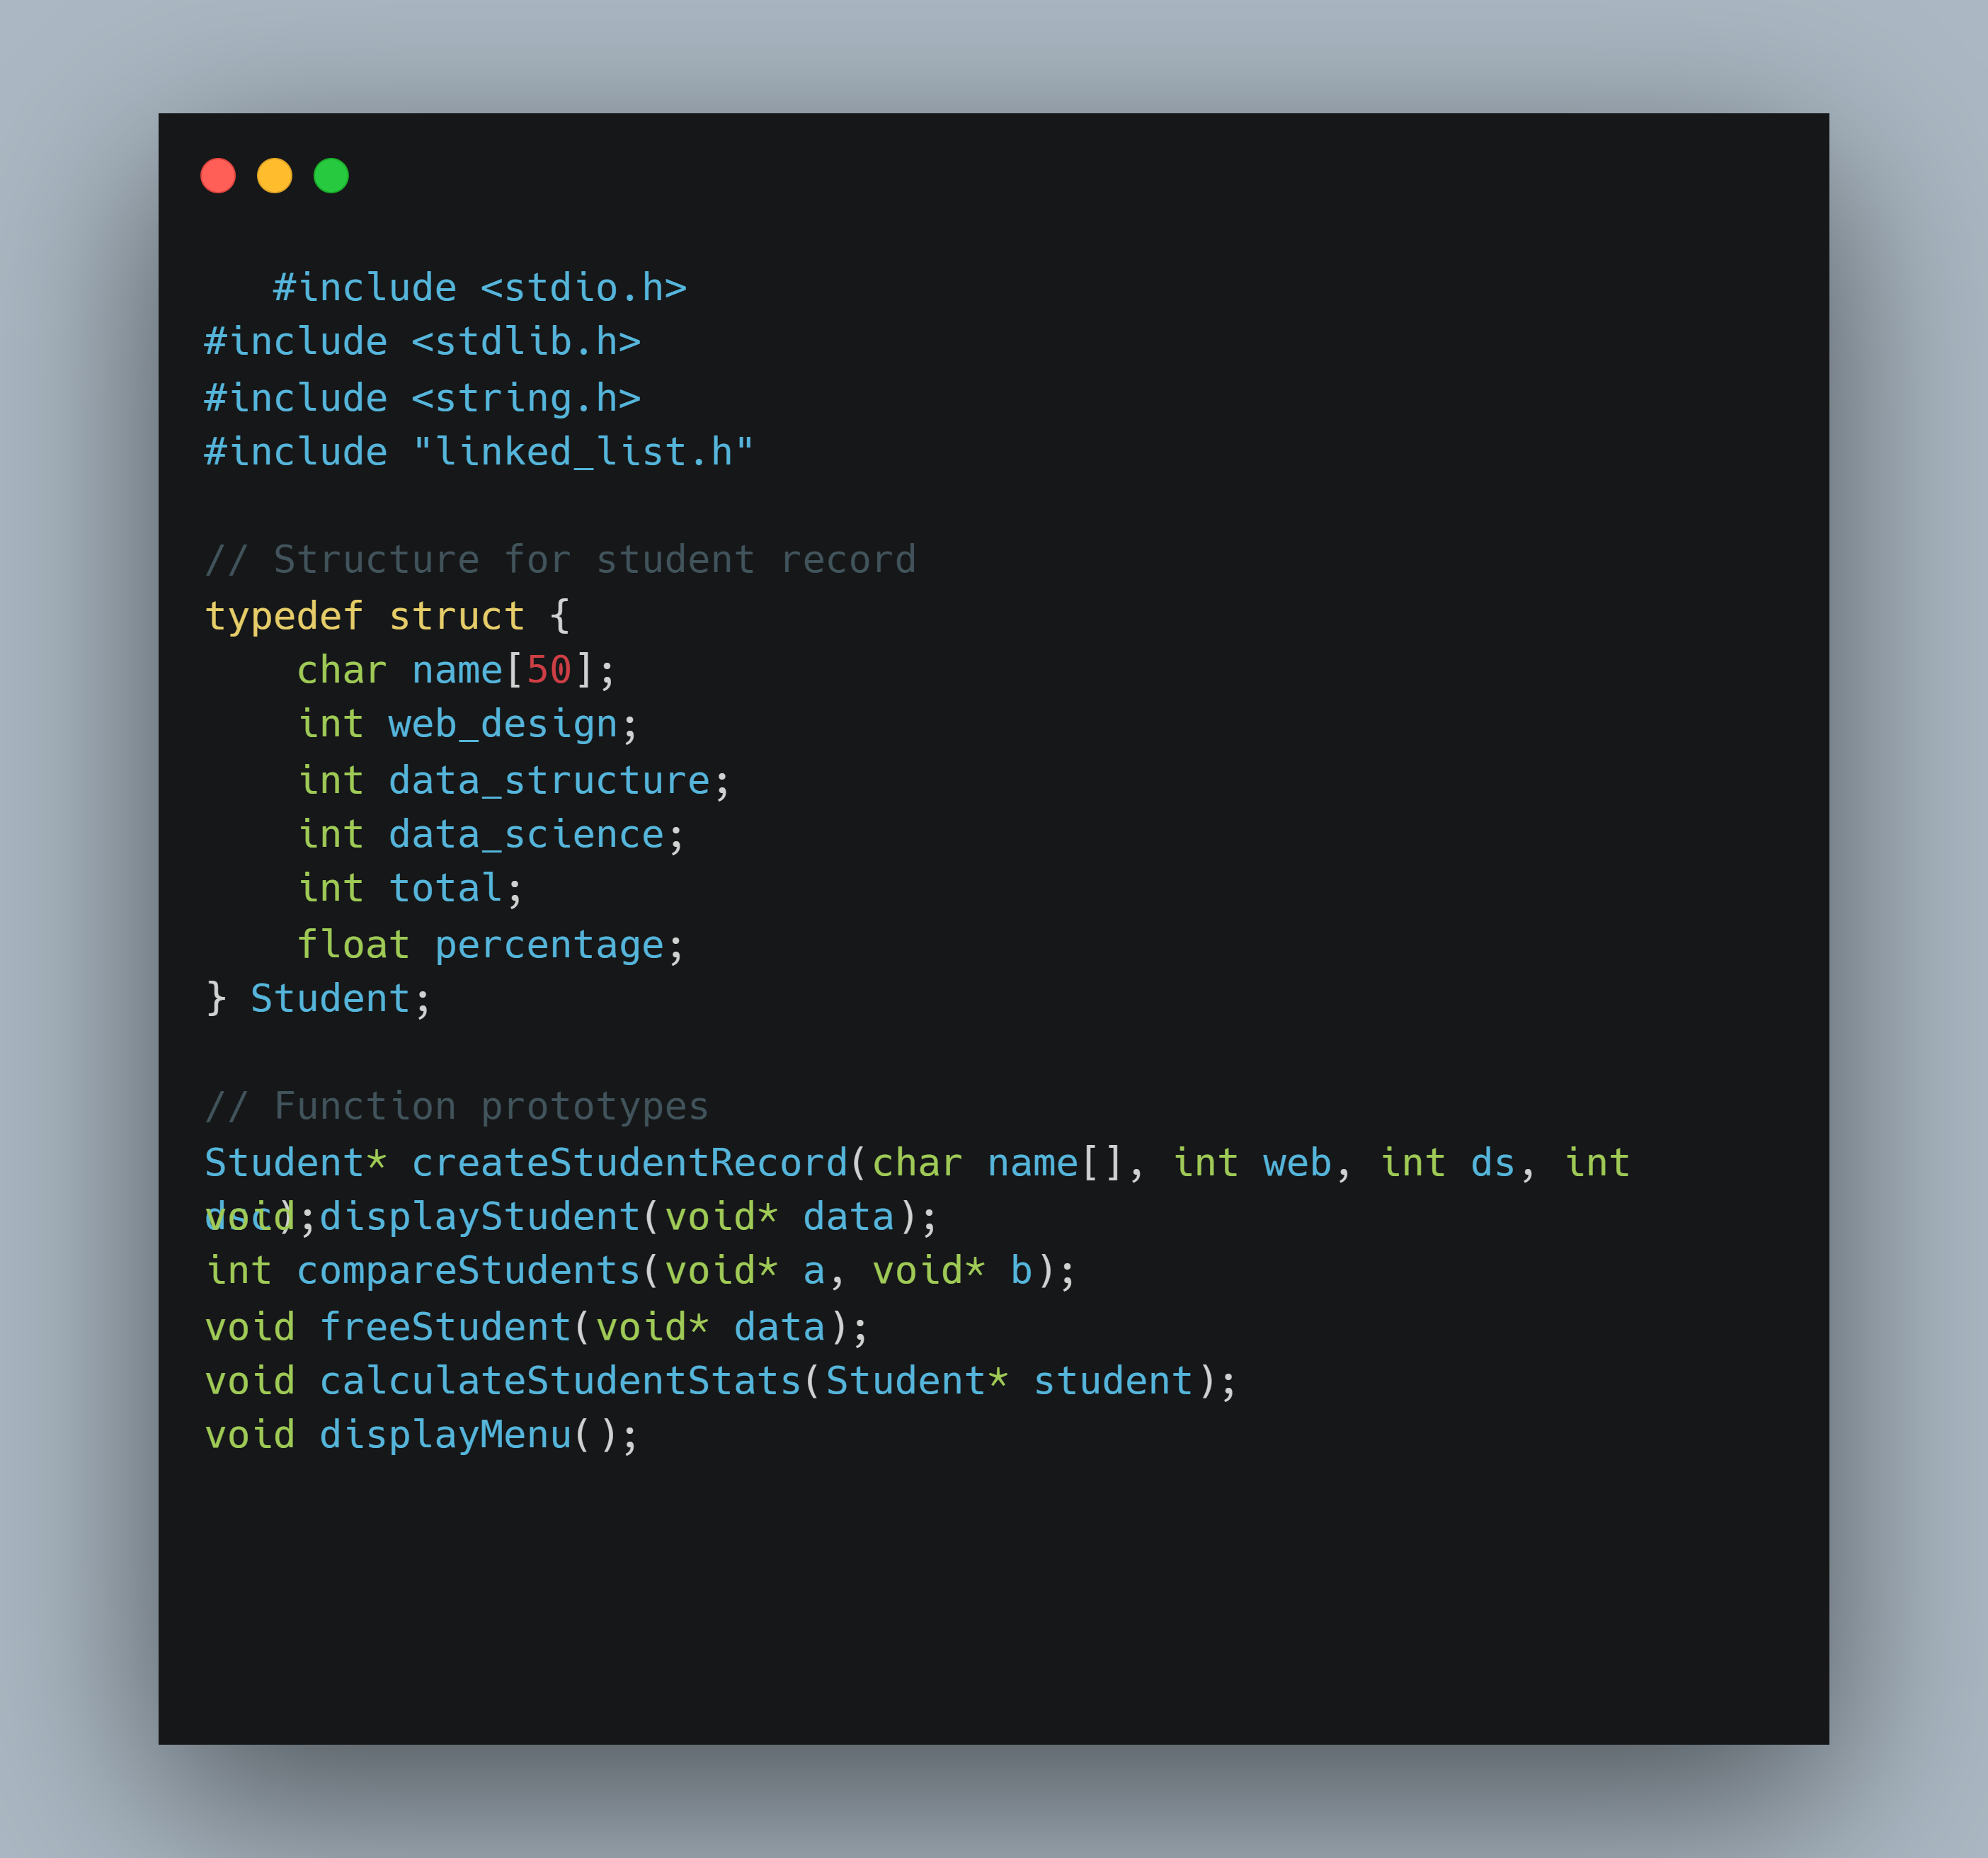

Slide 10
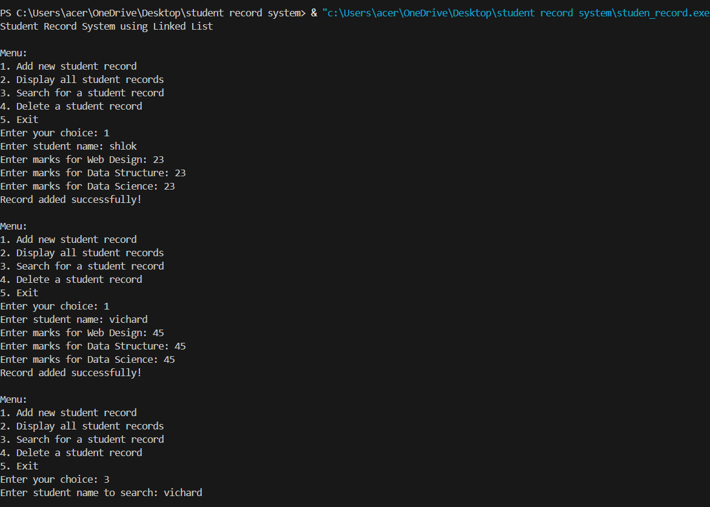
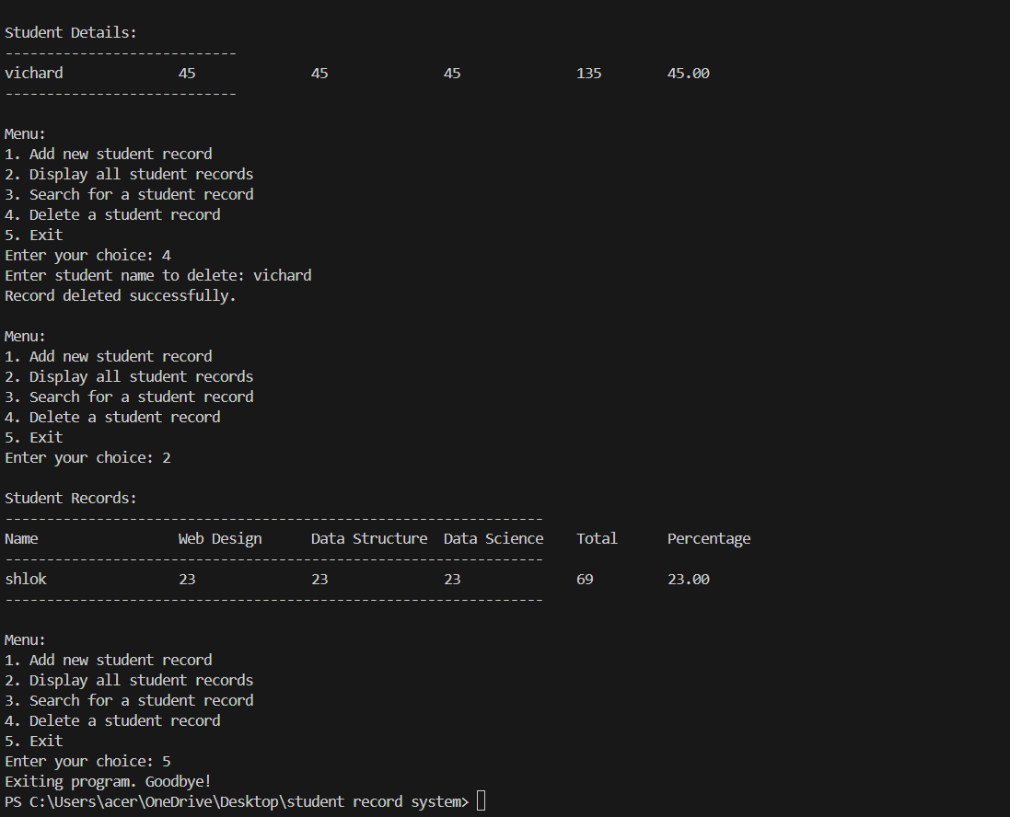
Output

Slide 11
Limitations
Console-based interface only
No persistent storage (data lost when program exits)
Basic error handling

